Slide 1
Parking Spots Allocation
Presentation and Detailed Report
Francisco Teixeira Lopes up201106912
Maria Eduarda Santos Cunha up201506524

Slide 2
Problem Description
This project concerns the allocation of parking lots to several cars. The cars have certain requirements regarding the kind of spot they prefer and negotiate with the various parking lots to assess which is the best one for them.
Decision variables:
cost hourly cost of parking in a specific Parking Lot / spot type
distance to parking lot measured between the Parking Lot and the current position of the Car agent
spot type regular, luxury and handicap

Slide 3
Global Scheme
RunAgents
RandomConfigParser
FixedConfigParser
Car Agent
CarAgentProposal::CarEvaluator
StrictCarEvaluator
LowerCostCarEvaluator
~agent
-eval
~agent
~proposal
LowerDistanceCarEvaluator
FlexibleCarEvaluator
CarBehavior
ParkingLotProposal
ParkingLotAgent
CarAgentProposal
Logger
-agent
~desiredSpots
-logMethod
~agent
ParkingLotBehavior
ParkingLotTimer
SpotType
LogMethod

Slide 4
Protocols and Interaction
Initiator
Participant
cfp
m
We based our protocol on FIPA Contract Net Interaction Protocol.
The main difference between our implementation and the original is we do not have the failure and inform-result : inform options.
Initiator Cars
Participants Parking Lots
i<=n
refuse
n deadline
j=n-i
propose
reject-proposal
k<=j
accept-proposal
l=j-k
failure
inform-done : inform
inform-result : inform

Slide 5
Initiator
Participant
1
Car issues a call for proposals which asks for m proposals from other Parking Lots and includes desired cost, distance and spot type.
Parking Lots receiving the call for proposals, considered potential contractors, generate n responses. Of these, j are proposals to perform the task, if they have at least one of the expect spot types, and i=n-j are refusals, if they do not have a single expected spot type.
After the deadline (10 seconds or when all answers are received, whichever happens first), the Car evaluates received j proposals and selects one or none Parking Lots to perform the task.
1
cfp
m
i<=n
refuse
n deadline
2
2
j=n-i
propose
reject-proposal
k<=j
3
accept-proposal
l=j-k
3
failure
inform-done : inform
4
inform-result : inform

Slide 6
Initiator
Participant
The l Parking Lots (one tops in our case) of selected proposals are sent an accept-proposal act and the remaining k Parking Lots receive a reject-proposal act.
Proposals are binding on the participant, which means, once the Car accepts the proposal, the Parking Lot must perform the task.
Once the Parking Lot has completed its task (Car is parked), it sends a completion message to the Car (inform-done : inform).
1
cfp
m
i<=n
refuse
n deadline
2
j=n-i
propose
reject-proposal
k<=j
4
3
accept-proposal
l=j-k
failure
inform-done : inform
4
inform-result : inform

Slide 7
Agents Architecture and Utilized Strategies
There is 1 class per agent and 1 class per behaviour.
There are 2 types of agents Cars and Parking Lots and a Car may have 4 different types of behaviour: Strict, Lower Cost, Lower Distance and Flexible.
best offer regarding cost and distance within certain limits
Agents are deliberative, since they consider options within certain boundaries.
StrictCarEvaluator.java
CarAgent.java
LowerCostCarEvaluator.java
best offer regarding cost
LowerDistanceCarEvaluator.java
best offer regarding distance
ParkingLotAgent.java
FlexibleCarEvaluator.java
best offer regarding cost and distance but allows going over the limits by a certain percentage value
Notes:
Estrategias -> comportamentos modulos que tem la (contract e iniator)

Slide 8
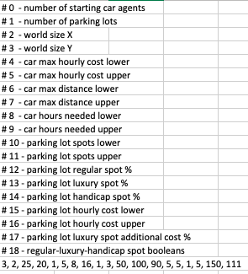
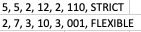
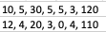
Other Mechanisms
How are our agents created?
In order to determine agents, when running the project, there are 2 possibilities considering different configuration files:
Randomize agents random.csv
Set specific agents cars.csv and lots.csv
random.csv
cars.csv
lots.csv
These configuration files essentially hold a sequence of numbers or tags that correlate to parameters of the proposals such as cost and distance bounds or type of spot, parameters relating to time a Car is allowed to spend in a Parking Lot and so on.
For easier understanding, all csv files have the meaning of each number/tag stated in the beginning.

Slide 9
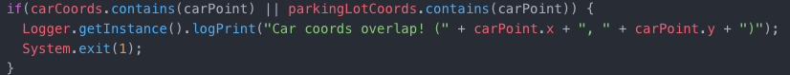



What are some important controlling aspects?
Controlling aspects are set in RunAgents.java:
As agents are created, both Car and Parking Lots, we check to make sure their coordinates never overlap.
Car agents are put into a Linked Blocking Queue where they each await their turn for negotiation, i. e., their chance to become the Initiator.

Slide 10



Performed Experiments
Cars
(5,5)
2
12
2
regular/luxury
strict
Coordinates:
Maximum hourly cost:
Maximum distance:
Hours needed:
Spot type:
Behavior:
(2,7)
3
10
3
handicap
flexible
Parking Lots
Coordinates:
Number of regular spots:
Number of luxury spots:
Number of handicap spots:
Hourly cost:
Luxury spot additional cost:
(10,5)
30
5
5
4
120
(100,100)
20
3
0
1
110

Slide 11
Results Analysis
As expected, the first car, StrictCar0, rejects both parking lots’ proposals, since the first parking lot, ParkingLot0, charges more than the car accepts to pay and the second, ParkingLot1, is much farther than the car intended.
The second car, FlexibleCar1, accepts the only proposal he receives, which is from the first parking lot, ParkingLot0. The first parking lot offered a slightly higher price per hour than the car wished for but due to its flexible behavior, that price falls within an acceptable range.
On the other hand, the second parking lot, ParkingLot1, simply refused to propose since it did not have the requested spot type to start with.
Testing Goals:
Parking Lot proposes if requested spot type is available and refuses if not
Car with strict behavior only accepts proposals with parameters below asked for (best cost and best distance)
Car with flexible behavior accepts proposals with parameters slightly higher than asked for (cost and distance)
Further testing goals are presented in section Execution Examples.

Slide 12
Conclusion
In the future, a good addition to our project would be the implementation of Iterated Contract Net Interaction Protocol since it is an extension of the protocol we opted for and allows for multi-round iterative bidding. Also, the inclusion of a graphical component would be interesting in order to display the process in a more user friendly manner, instead of showing only text in the console.
Overall, we believe we have matched the expectations of what was expected in this assignment. We had set out to develop a project which could allocate Parking Lots to several Cars according to the Cars’ specific requests and behaviours and the availabilities of those characteristics in the Parking Lots. Indeed, our program works precisely in this sense with the capability to generate all the agents and characteristics both by the user or randomly and we got to implement four different behaviours for our Car agents.
Used Software
JADE framework that allows for the development of distributed multi-agent systems in Java.

Slide 13
Report

Slide 14

Execution Examples
Running Instructions:
Open terminal in the jar file folder and run:
java –jar parking.jar FIXED ../configs/cars.csv ../configs/lots.csv for the possibility to edit cars and parking lots’ parameters
java –jar parking.jar RANDOM ../configs/random.csv if goal is to generate random parameters
FIXED parameters examples:
1 experiment
Cars
Both Cars and Parking Lots can never overlap.
(5,5)
2
12
2
regular/luxury
strict
Coordinates:
Maximum hourly cost:
Maximum distance:
Hours needed:
Spot type:
Behavior:
(5,5)
3
10
3
handicap
flexible
Notes:
Escalavel

Slide 15
1st experiment
2nd experiment
3rd experiment
Cars
(0,0)
4
10
2
regular
strict
Coordinates:
Maximum hourly cost:
Maximum distance:
Hours needed:
Spot type:
Behavior:
(0,0)
4
10
2
regular
lowdistance
(0,0)
2
10
2
regular
lowcost
similar to 3 experiments
Parking Lots
Coordinates:
Number of regular spots:
Number of luxury spots:
Number of handicap spots:
Hourly cost:
Luxury spot additional cost:
(10,10)
30
5
5
1
110
(5,5)
30
5
5
2
110
(4,4)
30
5
5
4
110

Slide 16



1st experiment:
Car chooses option which combines lowest cost and distance.
2nd experiment:
Car with lower distance behavior chooses parking lot with lowest distance between them despite cost.
3rd experiment:
Car with lower cost behavior chooses parking lot with lowest cost despite distance.
ParkingLot2 – 4€
10
ParkingLot1 – 2€
5
4
ParkingLot0 – 1€
Car
4
5
10

Slide 17
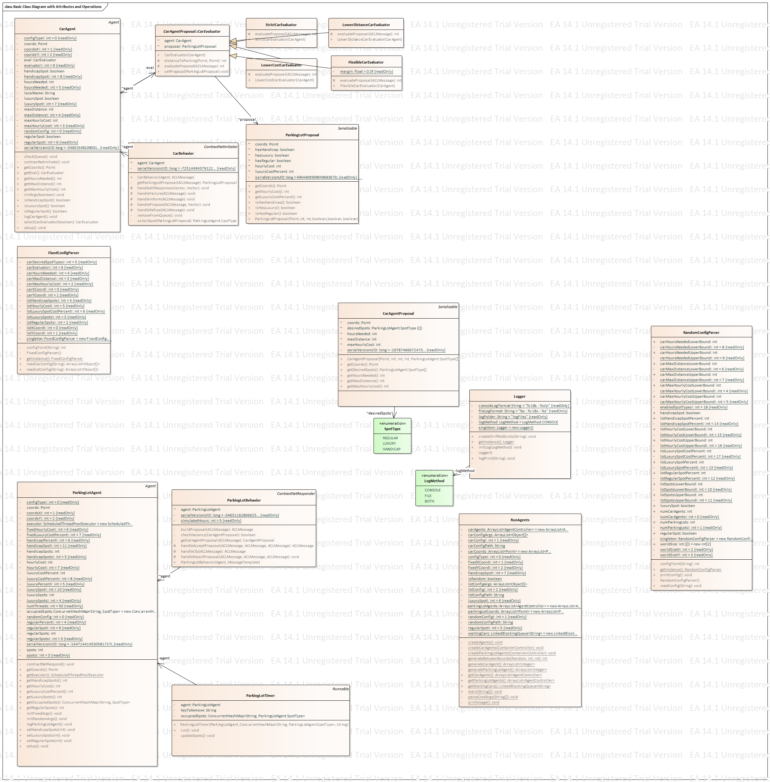
Implemented Classes
Constructors for agents Car and Parking Lot:
Essentially main class, where all methods are called and initiated:

Slide 18
Constructs a Car behaviour responsible for handling the ContractNetInitiator role in our FIPA ContractNet protocol. Sends a cfp message signalling the desired spot types to which Parking Lot agents respond with their proposals provided a spot of the desired type is available. The Car agent then evaluates the proposals and chooses to accept 0 or 1 of them.
Constructs a Parking Lot behaviour responsible for handling the ContractNetResponder role in a FIPA ContractNet protocol. Waits for a cfp message, sends a proposal and awaits acceptance or rejection of the proposal. A proposal may not be sent if the Parking Lot has no more spots of the requested type.

Slide 19
Encapsulates all the information needed for a Car agent to send a cfp message to the Parking Lot agents.
Encapsulates all the information needed for a Parking Lot agent to send a proposal message to a Car agent.
This set of classes is responsible for constructing Car evaluator objects which assign a value to Parking Lot proposals. According to the class, different parameters are taken into account.

Slide 20
Constructs a Parking Lot timer responsible for vacating a spot when the scheduled time has elapsed. Vacating a spot means updating the number of spots available on the Parking Lot used to construct the timer.
Information taken from configuration files is parsed and returned as a list of object arrays which can be later used to generate agents with those attributes.

